Slide 1
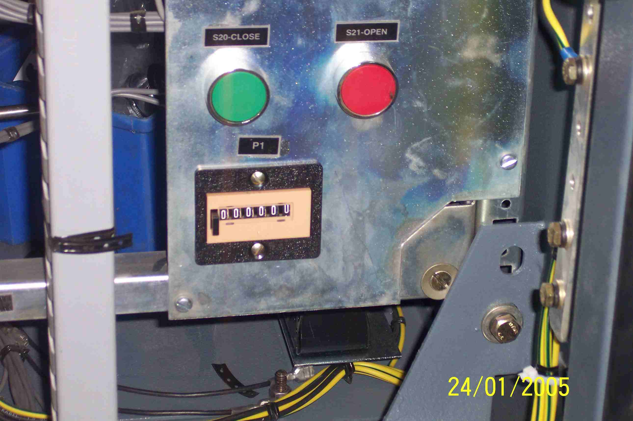
SIEMENS
HVCB SPARES
Operation Counter- Electrical
72.5KV,31.5KA,& 245KV ,50KA CB
110V DC : S4799093001; 220VDC : S4702504012

